Slide 1
Member Comparison Feature
Presenter Eren Arkangil

Slide 2
Question 1
How would you go about collecting and integrating the necessary datasets for the Member Comparison feature? What specific tools or techniques would you use?

Slide 3
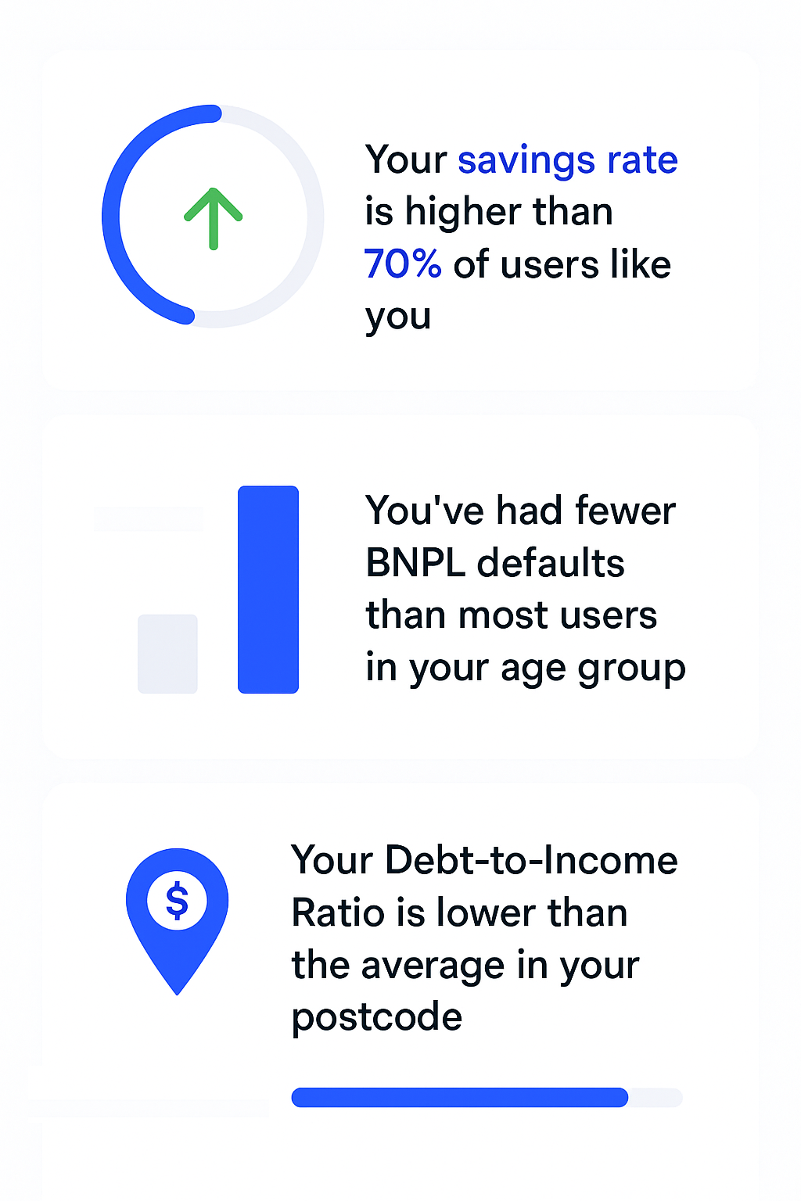
Planned Feature Mockup
 | Computation Method
 | Compute savings rates across users, segment by age/income, and rank percentile
 | Count missed BNPL payments per user, group by age band, calculate percentile
 | Compute DTI per user, aggregate by postcode, compare against group mean/median

Slide 4



ETL Pipeline
User-Linked CDR Data
Bank Balance, BNPL payments
via Basiq API
Data Lake (AWS S3)
Transform Data (ETL)
(Airflow triggers Python/SQL jobs to clean & normalize)
User Metadata
App Backend
1.Data Extraction (Schedule by Airflow)

Slide 5
Sample Data
Connection Type | Example Columns
Bank Accounts | transaction_id, amount, merchant, category, date, account_type
Credit Cards | credit_limit, balance, payment_due, min_payment,
BNPL (Afterpay, Zip) | repayment_due, overdue_amount, missed_payments, merchant_type
Superannuation | super_balance, contributions, provider_name, fees
Loans (Personal, Car) | loan_amount, remaining_balance, monthly_repayment
App Profile | user_id, age, gender, postcode, employment_status, income_type

Slide 6
Derived Metrics from Connected Data
Metric | Data Used | How It’s Derived
Savings Rate | Bank transactions → credits vs debits | (Total income - total expenses) / total income per month
DTI | Loan balances + credit card balance + monthly income | Debt-to-Income = total monthly debt repayment / monthly income
BNPL Defaults | BNPL account data | Count of overdue payments or repayments missed in last 90 days

Slide 7
Question 2
Once the data is collected, what steps would you take to clean and prepare it for analysis? Can you provide examples of potential data-cleaning challenges in this context?

Slide 8
Data Cleaning & Preparation
Challange | Solution | Example
Schema inconsistencies | Create a unified schema and map different field names to it | One dataset calls salary payments ‘income_payment’, another calls it ‘credit’ Both should mapped to ‘monthly_income’
Missing user fields | Missing user fields | If income is missing, estimate from regular incoming bank transactions; exclude if no reliable data
Sanity checks | Implement basic checks to validate data ranges and logic before analysis | Check that income > 0, dates are within expected range, and no negative transaction amounts
Different time windows | Align all data to the same analysis window (e.g., last full calendar month) | Bank transactions cover 90 days, BNPL only 30 days — cut both to last 30 days for fair comparison

Slide 9
Schema inconsistencies
Challenge: Different institutions (banks, BNPL providers, super funds) return data in varied formats. For example, income might be labeled as "credit" in one dataset and "income_payment" in another.
Solution:
Define a unified schema (e.g. transaction_type, amount, date, account_id, etc.)
Use mapping dictionaries to standardise category and field names
Validate key fields (e.g. all transactions must have a date and amount)

Slide 10
Missing user fields
Challenge: Some users may not connect all accounts (e.g., only connect bank but not BNPL), or fields like employer name or income may be missing.
Solution:
Use imputation where valid (e.g., infer income from consistent incoming transactions)
Flag incomplete profiles for exclusion from certain comparisons
Use conditional logic: only compute savings rate if both income and expenses are known

Slide 11
Different Time Windows
Challenge: CDR APIs may return data with different time windows (e.g., bank data for 90 days, BNPL for 30 days)
Solution:
Align all records to a consistent analysis window (e.g., last full calendar month)
Time-normalise features (e.g., calculate weekly averages)
Use rolling windows for trends (e.g., savings rate over last 3 months)

Slide 12
Question 3
What data modelling techniques and tools would you employ to identify patterns and trends in user financial behaviour for the Member Comparison feature?

Slide 13
Data Modelling Approach
Use K-means clustering to group users by similar financial behavior
Assign each user to a cluster representing their financial profile
Example output:
“Your savings rate is higher than 70% of users with similar financial profiles”

Slide 14
Feature engineering for clustering
These are normalized using MinMaxScaler or StandardScaler to bring them to the same scale.
Feature | How it's Derived
Monthly Income | From salary deposits
Monthly Expenses | Sum of outflows, excluding transfers/savings
Debt Amount | From loan, BNPL, credit card balances
Debt-to-Income Ratio | Debt / Income
Savings Rate | (Income - Expenses) / Income
Credit Score (if accessible) | Direct from provider
Missed BNPL Payments | Derived from payment schedule vs actual
Age | From user profile
Postcode | From user profile

Slide 15
Question 4
How would you ensure the privacy and security of user data while working on this project? Are you familiar with relevant data protection regulations, and how would you ensure compliance?

Slide 16
Data Privacy & Security
No personal info is used in comparisons Personal identifiers such as names, emails are excluded prior to analysis to ensure all comparisons use anonymized data.
Data is processed in a secure environment Data is processed securely inside a cloud platform like Redshift, where only authorized team members can access and analyze it
Users give permission to use their data Data is only used after members connect their accounts through the app and agree to share, following Consumer Data Right (CDR) and GDPR rules

Slide 17
Question 5
Could you outline how you would collaborate with the app development team to integrate the Member Comparison feature into the WeMoney app's user interface? What considerations would you keep in mind to provide a user-friendly experience?

Slide 18
UX Design: Define → Build → Refine
1
Define
Clarify Output: e.g. “You save more than 70% of users in your age group”
Define User Criteria: e.g., by age, income, or region
Trigger Conditions: Show messages only when sufficient data is available.
3
Refine
Simple Language: Use easy phrases (e.g., “You’re ahead of most users in saving”) instead “ Your rolling expenditure ratio outperforms cluster centroid”
Explainability: Add tooltips to train users e.g (i) Why I am seeing this?
2
Build
API Contracts: Specify how backend sends data to app (e.g., JSON format).
Alignment: Agree on data update frequency, format, and error handling

Slide 19
Question 6
Do you have experience with any specific data visualisation tools or libraries that could be used to present the insights generated from the Member Comparison feature's data?

Slide 20


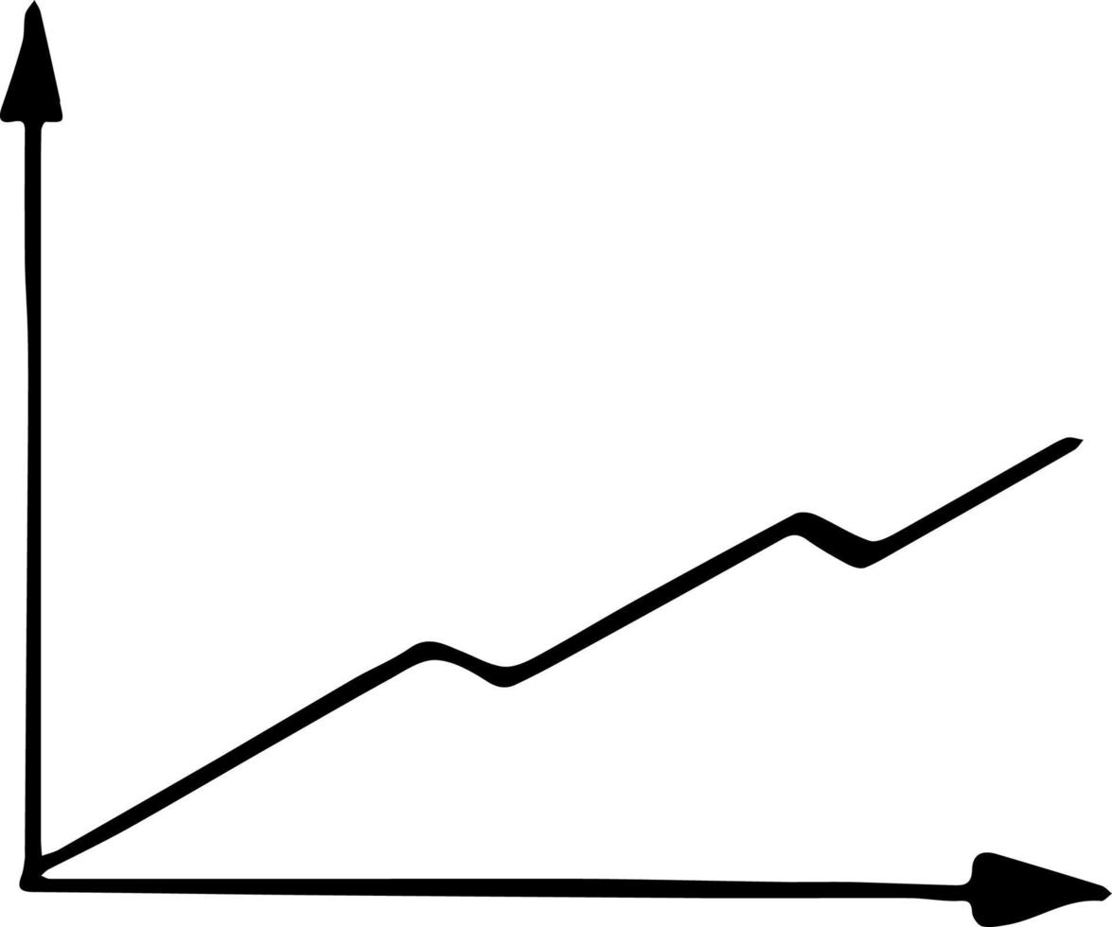
Data Visualization - Power BI or Tableau
1. Savings Rate by Age Group (Bar Chart)
Why: To compare how savings habits differ across age groups.
X-axis: Age groups (18–24, 25–34, 35–44, etc.)
Y-axis: Average savings rate (%)
3.Spending Breakdown (Pie Chart)
Why: To understand where the user’s money is going across major categories.
Slices: Groceries, Rent, BNPL, Subscriptions, etc.
2.Credit Score Trend Over Time (Line Chart)
Why: To monitor user’s credit score progress compared to peers.
X-axis: Time (months)
Y-axis: Credit score (User vs Peer Average)

Slide 21
Question 7
In terms of data, can you list the types of datasets you believe would be relevant for building the Member Comparison feature? How would you ensure data accuracy and quality?

Slide 22
Sample Data
Connection Type | Example Columns
Bank Accounts | transaction_id, amount, merchant, category, date, account_type
Credit Cards | credit_limit, balance, payment_due, min_payment,
BNPL (Afterpay, Zip) | repayment_due, overdue_amount, missed_payments, merchant_type
Superannuation | super_balance, contributions, provider_name, fees
Loans (Personal, Car) | loan_amount, remaining_balance, monthly_repayment
App Profile | user_id, age, gender, postcode, employment_status, income_type

Slide 23
Ensure Data Quality
Structural Checks Identify and resolve missing values, nulls, or duplicate entries in critical columns such as transaction amount or account ID.
Business Rule Validation Apply logic-based rules, such as ensuring that the transaction date occurs after the account open date, or that total expenses do not exceed income for an extended period.
Relational Integrity Ensure that foreign keys, such as user ID in the transactions table, correctly link to primary keys in the users table. There should be no orphan records.
Contextual Consistency Validate that values make real-world sense. For example, a 20-year-old user should not have 30 years of credit history.
Accuracy and Quality Controls Implement automated validation pipelines with unit tests, schema enforcement, and business logic checks.

Slide 24
Question 8
How would you approach the challenge of handling potentially large volumes of user data, given the scalability requirements of a growing user base?

Slide 25
Scalability for Large User Data Volumes
1. Columnar Data Warehouse: Amazon Redshift
Optimised for analytics and reporting at scale.
Stores financial data (transactions, income, debts, etc.) in columnar format.
Supports fast queries using distribution/sort keys (e.g., sort by age or postcode for comparisons).
2. Batch Processing for Heavy Computations
Use AWS Glue or Apache Spark to run scheduled ETL jobs.
Compute intensive metrics (e.g., debt-to-income ratio, savings rate, clustering outputs) offline in batches.
Store pre-aggregated results back in Redshift, ready to be served via APIs.
3. Scalable Storage & Access
Raw financial data from connected accounts (banks, BNPL, super) lands in Amazon S3.
Use Parquet format for efficient storage and loading during ETL.

Slide 26
Question 9
Can you provide examples of similar projects or experiences you've had that demonstrate your ability to contribute effectively to the development of the Member Comparison feature for WeMoney?

Slide 27
Customer Segmentation at Getir
At Getir, I helped develop customer segments based on behavioral and spatial data
For example, we identified groups like “promotion hunters” who respond to discounts, and “night buyers” active after 10 pm
These patterns were used to personalize marketing strategies for different user types
This experience aligns closely with the “members like you” approach, identifying financial behavior clusters and surfacing personalized comparisons
Additionally, at Rassure, we clustered large volumes of transaction records to support the QA team in identifying ADM penalty cases,a similar challenge of pattern recognition and segmentation at scale

